Slide 1
Data Analytics and Visualization for Digital Forensics
Module 3, Day 3
Dr.ir. Hans Henseler,
University of Applied Sciences Leiden (NL)
Master of Advanced Studies in Digital Forensics & Cyber Investigation
Bern University of Applied Sciences

Slide 2
Module 3: Data Analytics and Visualization
This module teaches the use of data analytics and visualization for digital forensics. Topics covered include:
Log analysis and correlation
Event reconstruction using timelines
Using Plaso to create super-timelines
Working with Big Data repositories
Correlation and relationship analysis
Statistical analysis
Advanced search techniques

Slide 3
Day 3 schedule
Day 3 | The ELK stack
08:30 | Part 5: Use case: Maastricht University ransomware attack
 | What is ELK? Introduction to Logstash and Kibana
10:30 | Exercise 5: Setting up your own ELK environment to analyse and visualize data extracted with Plaso tools
12:00 | Lunch
13:00 | Part 6: ChatGPT as a copilot for data analytics and visualization in digital forensics
14:30 | Student project part 1/2: design a project that you will finish Friday
15:45 | Present your design/idea to the class (2 slides, 2-4 min pp)
16:30 | End of the day

Slide 4
Day 3: Learning Goals
What is the ELK stack?
Work with OpenSearch Dashboard VM:
Load data with Psort.py in OpenSearch
OpenSearch:
index pattern
discover data
dashboard
What are large language models and how can they help you in data analytics and visualization for digital forensics
Design and setup a digital forensics analysis and visualisation project

Slide 5
Part 5: What is ELK and why do you need it?

Slide 6
Maastricht university ransomware attack
Short case study of a cyber investigation into a ransomware attach

Slide 7
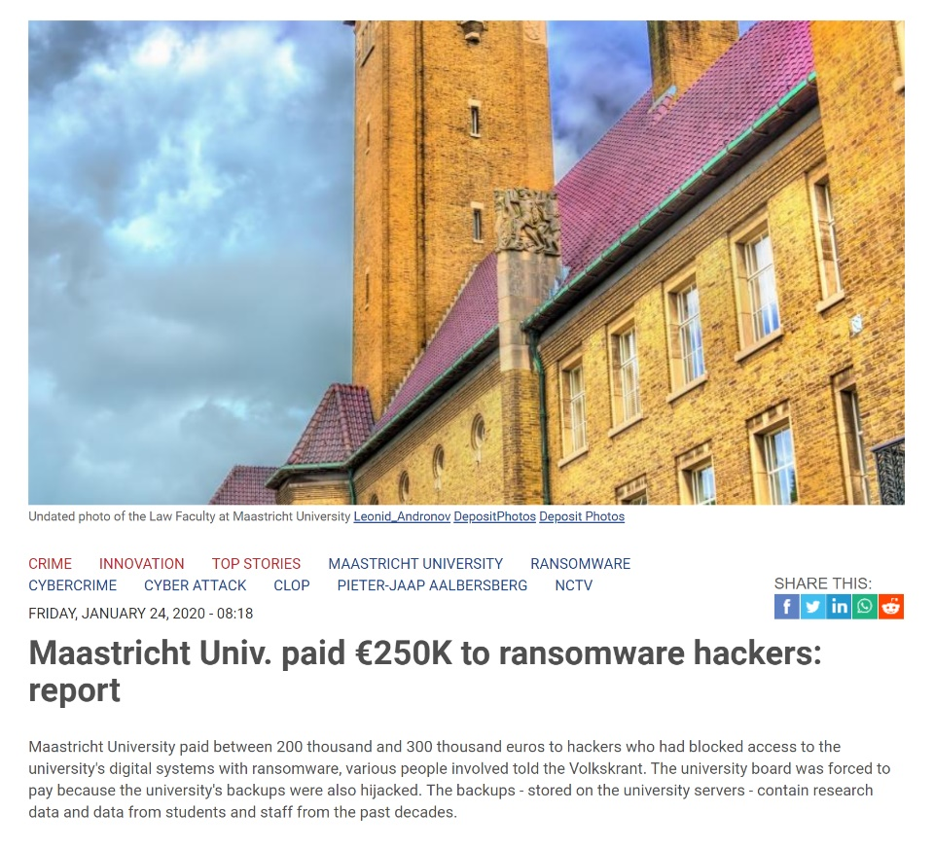
Maastricht University hit by ransomware attack
“Just before Christmas 2019, Maastricht University was hit by a cyberattack involving ransomware. The attack took down all of the university's systems. Staff and students were unable to use their email programs and the university's research activities were also seriously disrupted.”

Slide 8
Identification of the suspect
Fox-IT threat intell identifies the Dridex-RAT-group:
“Ransomware in a Microsoft Windows domain environment”
Over 150 victims in 2019 show similar modus operandi:
Infect one or more systems via phishing emails
Identification of the target organisation
Lateral movement through the network from infected workstation
Delete or encrypt backups
Roll-out of the ransomware accross as many servers in the network
Demand ransom by email
The information presented here has been obtained from the Fox-IT investigation report that was made public by Maastricht University:
https://www.maastrichtuniversity.nl/um-cyber-attack-symposium-%E2%80%93-lessons-learnt

Slide 9
Digital Forensic Investigation
What you can read in the report from project Fontana:
Collect digital evidence from sources in the network
This is done incrementally as the investigation progresses
Batches of collected evidence are uploaded to the forensic lab
Data collection is restricted to “Indicators of Compromise” (IOCs)
When a new IOC is identified, additional data is collected
IOCs can be used by others to protect against this attack

Slide 10

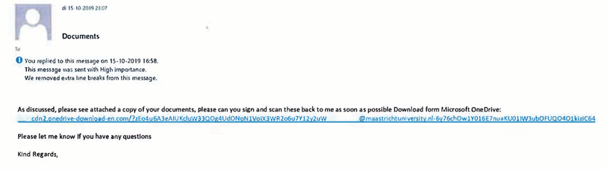
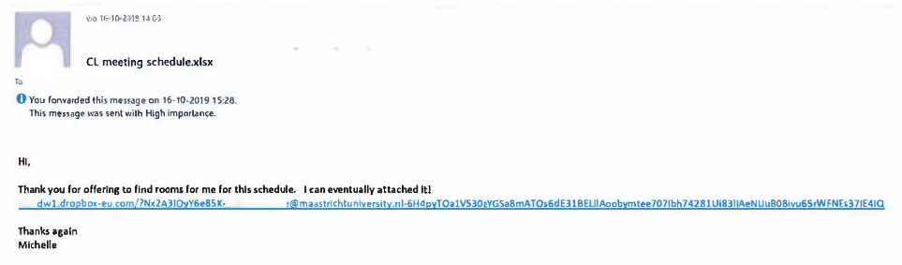
October: The initial compromise via Phishing mails
Malware was downloaded from an external IP address SDBBOT
This malware was executed on multiple systems inside the network of the University
It downloaded additional packets from an external website and became persistent on the windows computer(s)

Slide 11

November: Spreading through the network
The software the SDBBOT downloaded is Meterpreter and is used by attackers to access infected desktop computers
After app. 1 week the attackers gain access to servers in the network and install Meterpreter.
Powersploit is installed: a collection of PowerShell-scripts that can be used to test the security of the network.
PingCastle is installed on a virtual workstation to visualise the active directory of the University network
In November the attacker is able to obtain network admin privileges using the account administraor.unimaas.

Slide 12

December: Preparing the ransomware attack
The attackers use the domain admin account to further explore the Unimaas active directory and network structure
Just before Christmas the attacker started preparing the ransomware attack (i.e. roll out of the ransomware software)
Windows Defender was switched off before starting the ransomware
In 25 minutes all files at 267 servers were encrypted. This also included back-up servers.

Slide 13
Collected evidence: system data
Type | ID | System name | Data type | Acquired on | Description
System data | IEV1 | 321 | Disk and RAM image | 30-Dec-19 | Disk and RAM image from ****.321
System data | IEV3 | UM-**** | Memory image | 30-Dec-19 | RAM image from server UM-****
System data | IEV10 | 316 systems | Acquire data | 2-Jan-20 | Collection of forensic artifacts from 316 systems, part 1
System data | IEV10 | 316 systems | Acquire data | 14-Jan-20 | Collection of forensic artifacts from 316 systems, part 2
System data | IEV5 | WS-**** | Disk image | 6-Jan-20 | Disk image from workstation WS-****
System data | IEV7 | UM-**** | Disk image | 2-Jan-20 | Disk image system partition from Domain Controller UM-****
System data | IEV9 | UM-**** | Disk image | 3-Feb-20 | Disk image from 2 servers
System data | IEV11 | UM-**** | Disk image | 9-Jan-20 | Disk image from CORSA UM-****
System data | IEV12 | UM-**** | Disk image | 10-Jan-20 | Disk image from Syllabus server UM-****
System data | IEV17 | 15 systems | Acquire data | 20-Jan-20 | Collection of forensic artifacts from various servers
System data | IEV20 | UB-**** | Disk image | 21-Jan-20 | Disk images from two servers

Slide 14
Collected evidence: Log files, network data and misc.
Type | ID | System name | Data type | Acquired on | Description
Network data | IEV13 | Firewall | Flowlogs | 14-Jan-20 | Metadata van netwerkverkeer tussen 2019-07-03 en 2019-12-25
Other data | IEV2 |  |  | 30-Dec-19 | Disk image from first infected virtual workstation
Other data | IEV3 |  |  | 30-Dec-19 | Encrypted files
Other data | IEV8 |  |  | 3-Jan-20 | SDBbot malware and related registry keys
Other data | IEV16 |  |  | 14-Jan-20 | EPO databases
Other data | IEV18 |  |  | 21-Jan-20 | Mailboxes from account: ******** and ********
Log files | IEV3 | DNS requests | Splunk | 30-Dec-19 | Alle DNS-verzoeken sept/okt/nov/dec 2019 naar domein: drm_server13-loginmicrosoftonline
Log files | IEV14 | UM Domain Controller | Splunk | 20-Jan-20 | Windows Event Log en netlogonlogbestanden van Domain Controller UM-****
Log files | IEV15 | UM-FS | Splunk | 14-Jan-20 | Windows Event Log logbestanden van MUSL-share op UM-FS

Slide 15
Why ELK?
Rapid on-premise (or cloud) installation and easy to deploy
Scales vertically and horizontally
Easy and various APIs to use
Ease of writing queries, a lot easier then writing a MapReduce job
Availability of libraries for most programming/scripting languages
Elastic offers a host of language clients for Elasticsearch, including Ruby, Python, PHP, Perl, .NET, Java, and Javascript, and more
Tools availability
It’s free (open source), and it’s quick
Notes:
Vertical scaling is more server resources , e.g. cpu cores, ram, diskkspace etc.

Slide 16
ELK Pipeline
Logstash
Data From Any Source
Logstash is a log pipeline tool that accepts inputs from various sources, executes different transformations, and exports the data to various targets
Elasticsearch
Instantly Search & Analyze
Elasticsearch is a NoSQL database that is based on the Lucene search engine
indexes and stores the information
Kibana
Actionable Insight
Kibana is a visualization layer that works on top of Elasticsearch
presents the data in visualizations that provide actionable insights
collects and parses logs

Slide 17
BEK or ELK-B Pipeline
Beats
Data From Any Source
Beats is for leightweight data collection with less data processing capabilities than Logstash
Elasticsearch
Instantly Search & Analyze
Elasticsearch is a NoSQL database that is based on the Lucene search engine
indexes and stores the information
Kibana
Actionable Insight
Kibana is a visualization layer that works on top of Elasticsearch
presents the data in visualizations that provide actionable insights
collects data

Slide 18
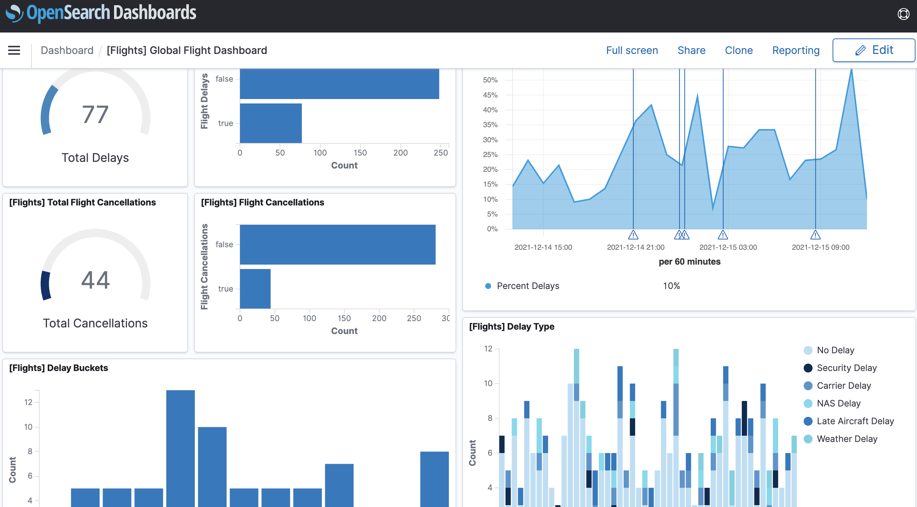
Focus on OpenSearch Dashboard today
Instead of Logstash we will use Plaso tools to export events as we learned in Part 3 on day 2
In Part 4 on day 2 we learned about Elasticsearch and practiced how we can use Psort.py to export events into an OpeSearch index.
The focus in Part 5 will therefore be on Kibana and how we can visualise events that have been indexed by Elasticsearch

Slide 19

OpenSearch Dashboard:general information
Web-based application for exploring and visualizing data
Modern Browser-based interface (HTML5 + JavaScript)
Search, view, and interact with data stored in OpenSearch indices
Execute queries on data & visualize results in charts, tables, and maps
Add/remove widgets
Share/Save/Load dashboards
Apache 2.0 license

Slide 20
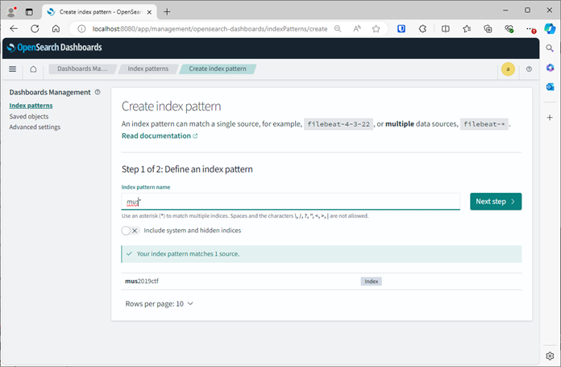
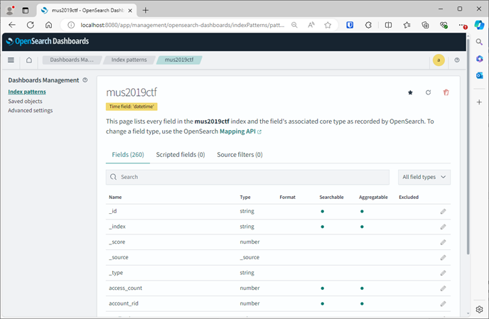
After we have put data in OpenSearch

Slide 21
Define an index pattern
Creating an index pattern is a 2-step process:
Step 1: Define an index pattern
Type the first character if the index name (so that would be mus2019ctf) and select next.
Step 2: After selecting the index you have to configure settings
Select the Time field. This is easy since there is only field available: datetime. Then select Create index pattern
In the next field you can edit Field properties. Note that there are 250 fields in our index!
For now, we won’t change anything. We will leave the Management section and go back to home.

Slide 22
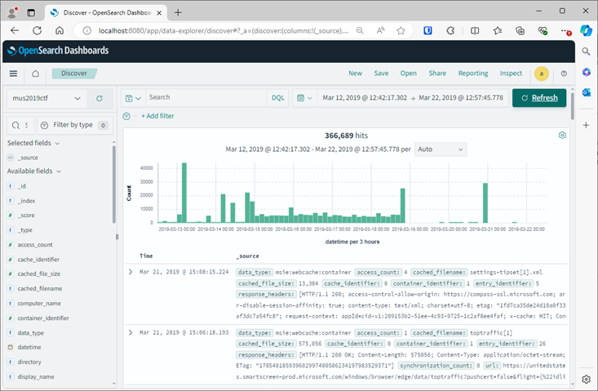
Discover data with Kibana

Slide 23
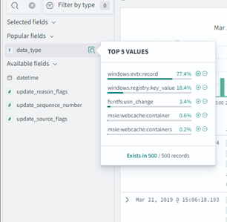
Interactive discover fields
On the left side you see there are 47 different fields available in this time frame. You can search for names. Type in date and select the date_type field. There is a pop-up showing you the values for this field.
This works so much easier then the Elasticsearch json query syntax that we tried on Day

Slide 24
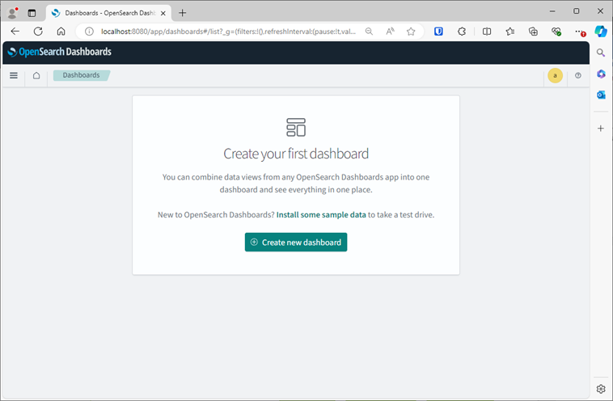
Visualize data with Kibana

Slide 25
9:40-10:00

Slide 26
Exercise 5: Setting up your own OpenSearch Dashboard environment to analyse and visualize data extracted with Plaso tools

Slide 27
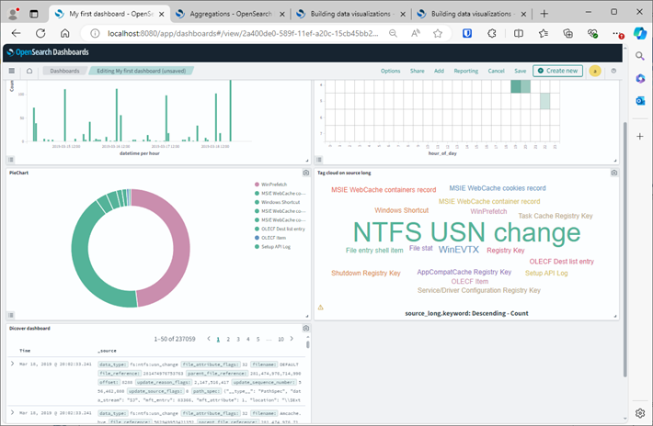
Exercise: Build a OpenSearch Dashboard
Build a dashboard that contains:
a Barchart,
a Heatmap and
a Piechart
a TagCloud
a table
See instructions in the PDF file (new version will be sent in the MsTeams chat and is on Github).
Start at step 1

Slide 28
12:00-13:00

Slide 29
Part 6: ChatGPT as a copilot for data analytics and visualization in digital forensics

Slide 30
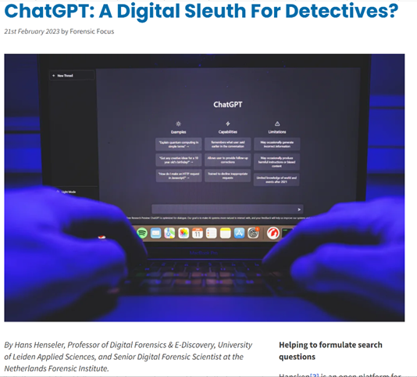
Outline
The rise of deep learning
What is ChatGPT?
What can ChatGPT do?
What can ChatGPT not do?
ChatGPT and digital evidence
Topics for future work
https://www.forensicfocus.com/articles/chatgpt-a-digital-sleuth-for-detectives

Slide 31
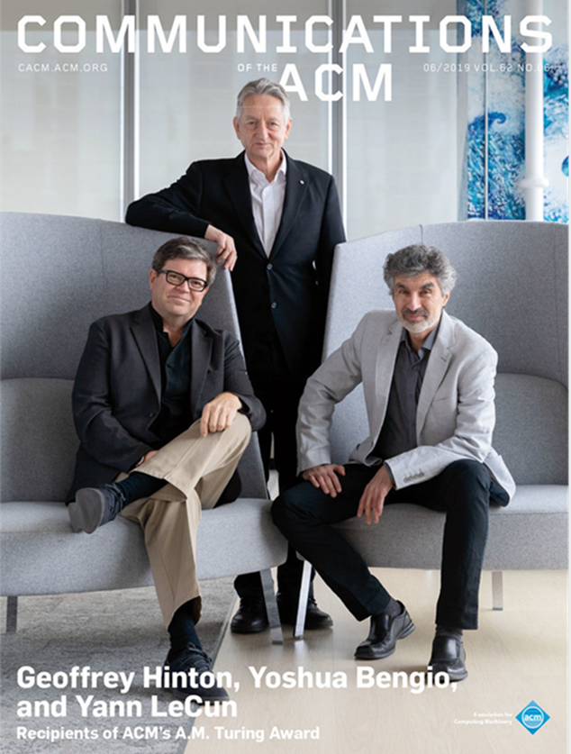
The rise of deep learning 2012-2024
2012: AlexNet wins the ImageNet Large Scale Visual Recognition Challenge
2014: Introduction of Generative Adversarial Networks (GAN's)
2015: AlphaGo defeats world champion Go, Lee Sedol
2017: Google introduces BERT improving ML translations
2018-2021: Introduction of GPT-2, DALL-E, CLIP, GPT-3, …
2022: DALL-E2, Midjourney, Stable Diffusion, ChatGPT, …

Slide 32
Copilot opportunities
Chat. Like a chatbot that…
Assists with writing and brainstorming
Tells riddles, jokes, stories
Plays games
Gives compliments and advise
Helps with filling in forms
But that can also:
Summarise
Translate
Analyse and structure (unstructured) information
Answer questions (but the answer may not be right)
Assist with software writing and debugging
Generate (anonymous) testdata

Slide 33
Copilot challenges
It hallucinates facts
It gives wrong answers
Replies can be biased
Can not act spontaneously (needs to be prompted)
Can accidentally reveal sensitive training data
…?
REMINDER
use LLMs as
co-pilot

Slide 34


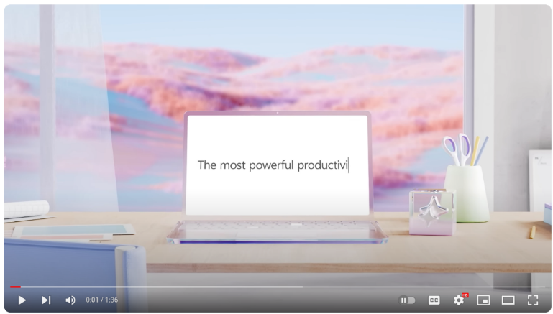

Microsoft Copilot
2021 GitHub Copilot
Last year in 2023:
February 1: Bing Chat
September 26 : Windows 11 Copilot
November 1: Microsoft Office 365 Copilot:
Introducing Microsoft 365 Copilot | Your Copilot for Work - YouTube

Slide 35
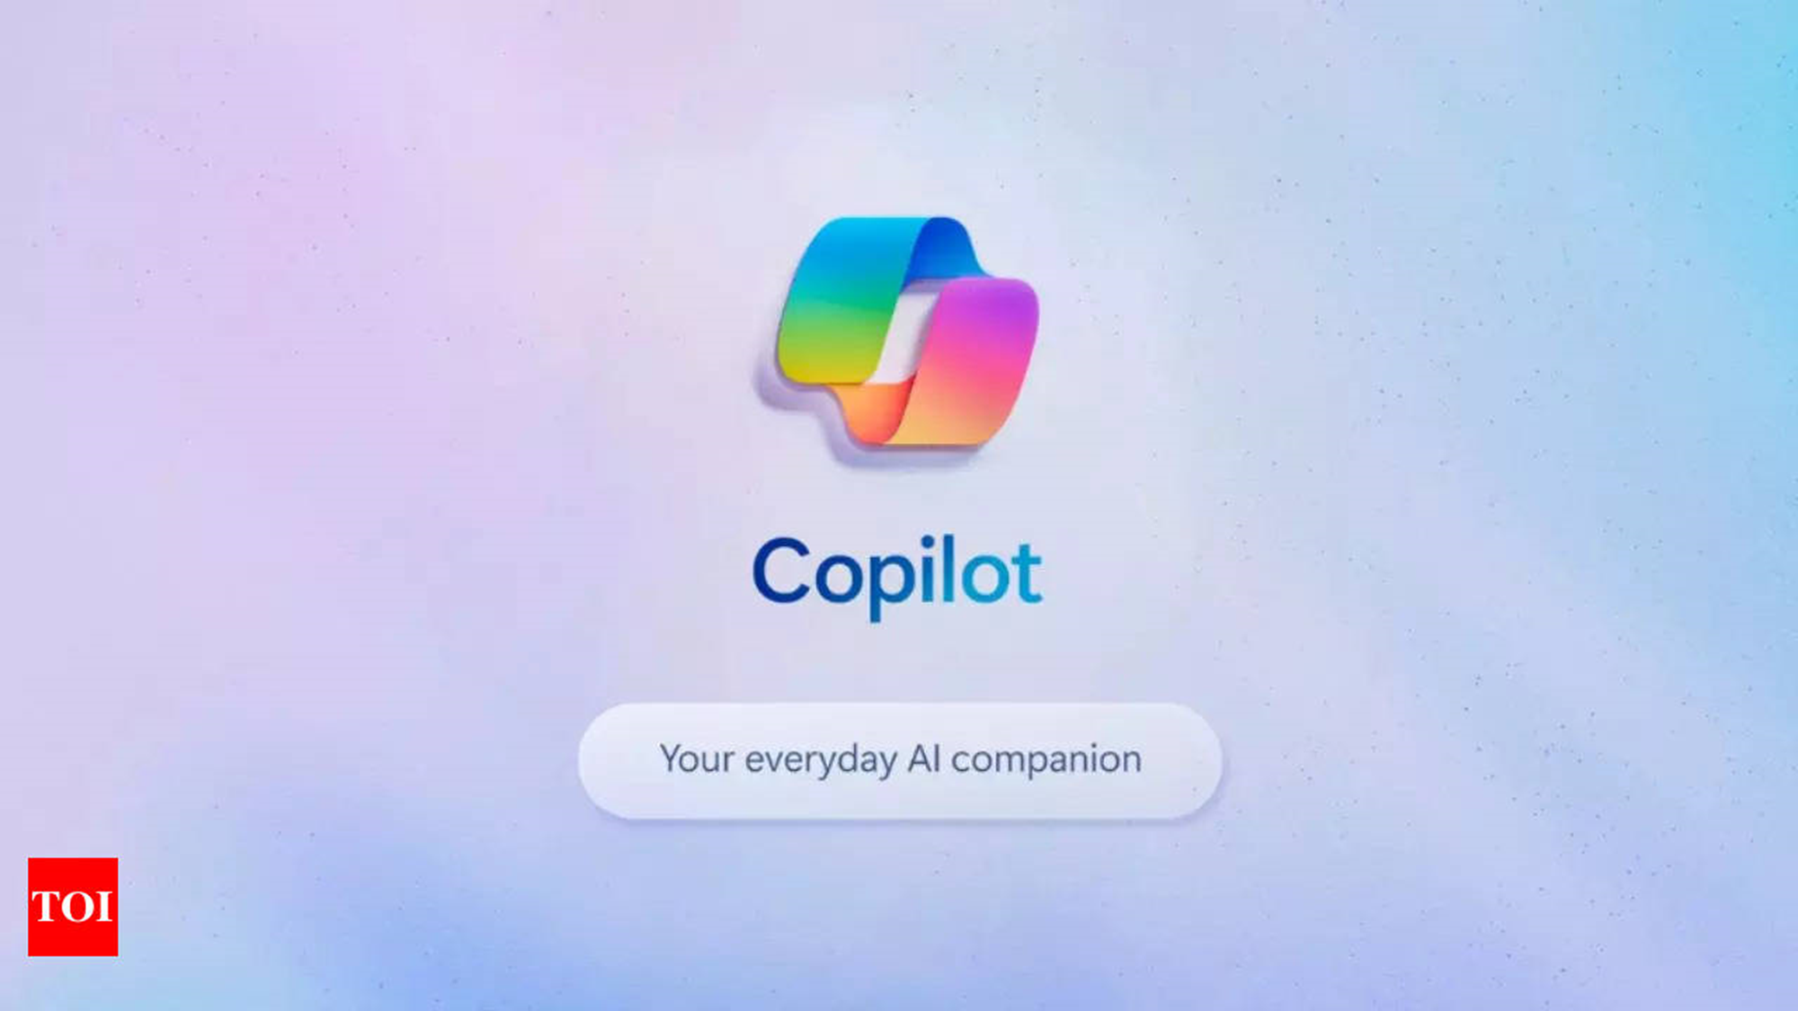
Microsoft Copilot + PC (May 21st)
Help you with using Windows
Even with playing video games
On device semantic index and 40 different LLMs
Recall (opt in):
application that can help you find back information on your device.
New hardware specs:
Neural Processing Unit NPU 40TOPS (Trillion Operations per Second)
Microsoft Surface and computers/laptops from:
Dell, Acer, Asus, Lenovo, HP etc.
Build 2024 keynote
https://www.youtube.com/watch?v=aZbHd4suAnQ

Slide 36
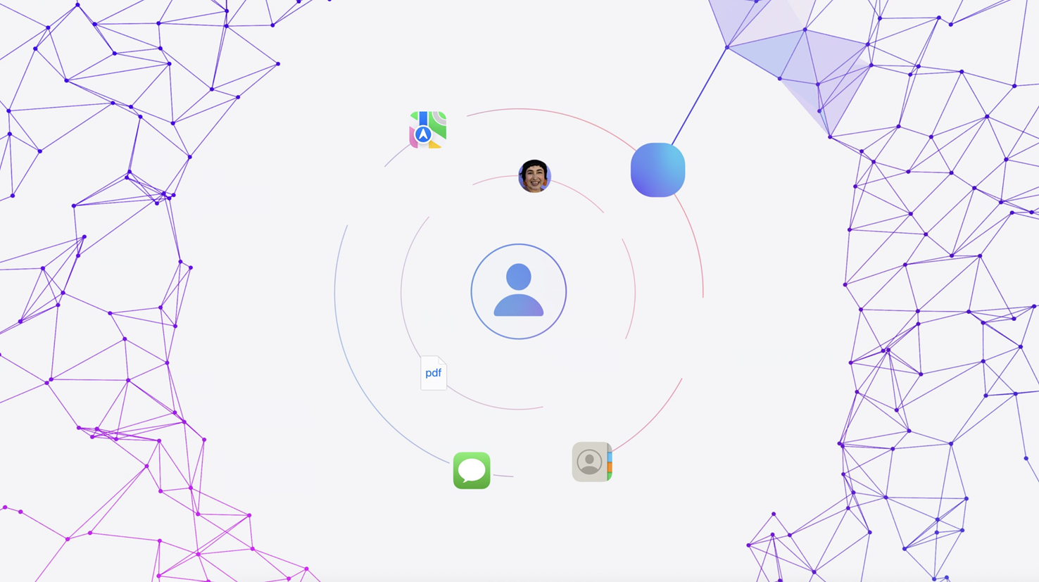
Apple Intelligence (June 10th)
MacOS, iOS and iPadOS
On device semantic index
Apple’s personal copilot for users
WWDC2024 keynote chapter: https://www.youtube.com/watch?v=RXeOiIDNNek&t=3870s

Slide 37

Enhancing Digital Investigations with ChatGPT
Our 4 case study experiments:
Writing search queries
Summarising chat conversations
Analysing search results
Reverse engineering
Midjourney prompt: photorealistic picture of a digital sleuth in the style of Sherlock Holmes as a robot investigating a crime scene with digital traces in smartphones and computers (fast)

Slide 38
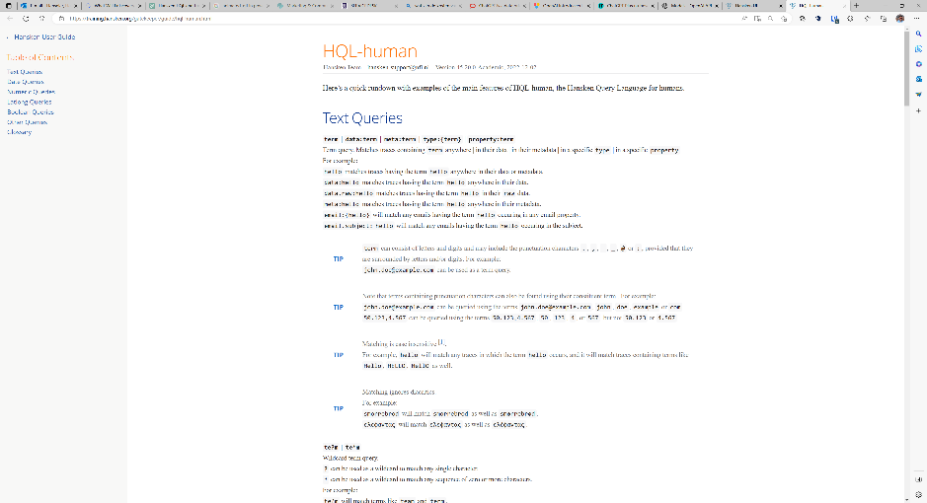
Writing search queries
Prompt ChatGPT with:
Hansken Query Language (HQL) manual

Slide 39
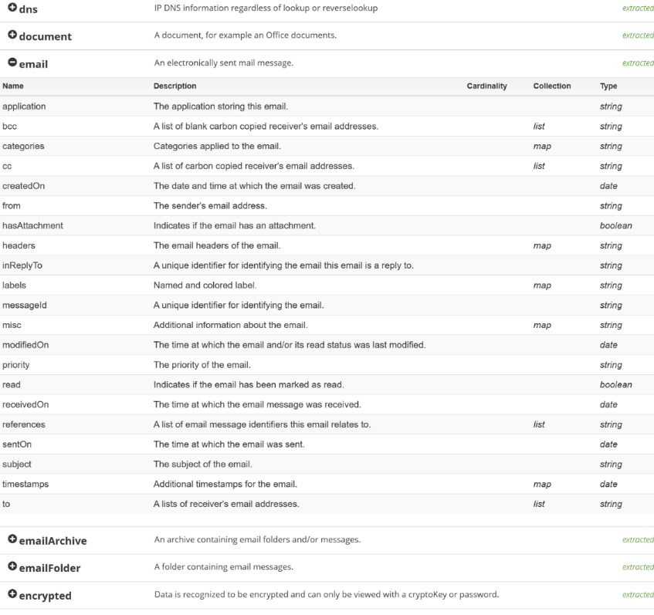
Writing search queries
Prompt ChatGPT with:
Hansken Query Language (HQL) manual
Hansken trace model types

Slide 40
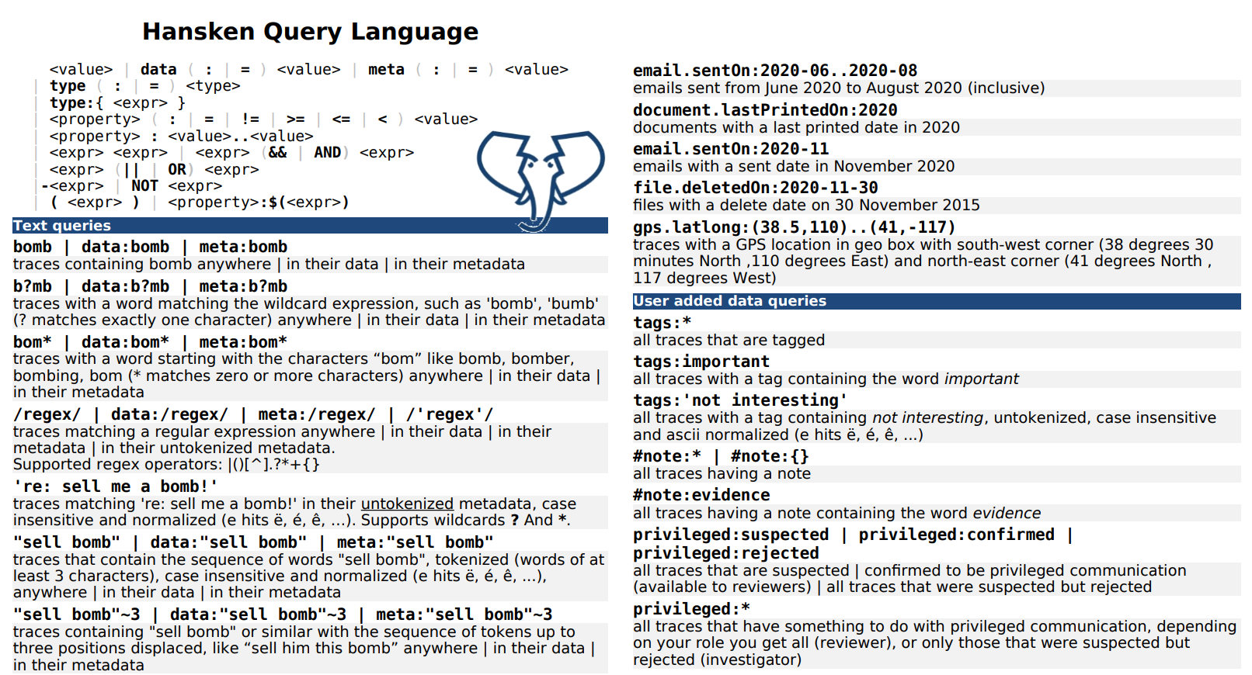
Writing search queries
Prompt ChatGPT with:
Hansken Query Language (HQL) manual
Hansken trace model types
HQL cheat sheet

Slide 41
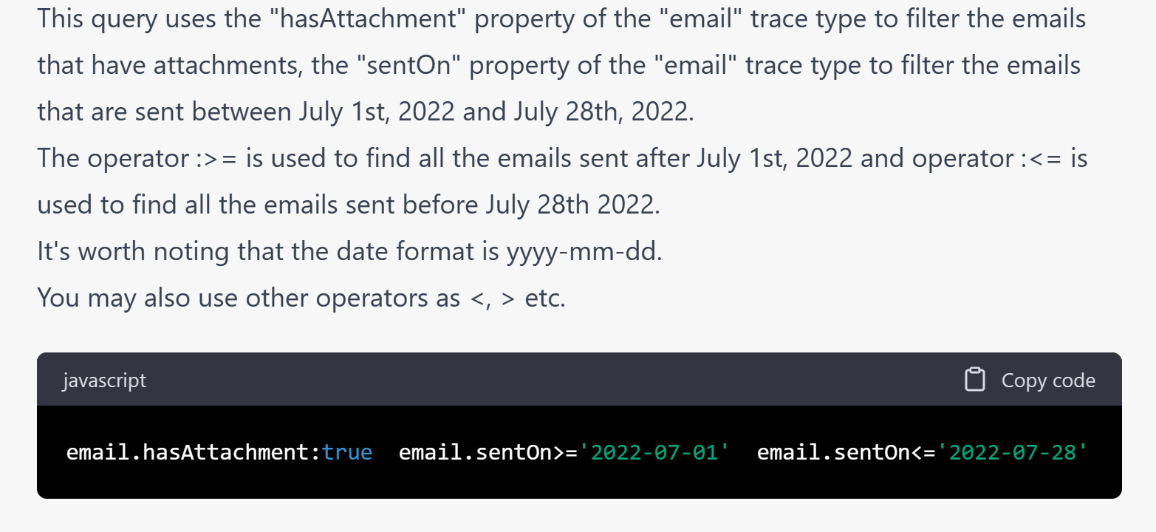
Writing search queries
Prompt ChatGPT with:
Hansken Query Language (HQL) manual
Hansken trace model types
HQL cheat sheet
Instruction
“Find Email traces with attachments that are sent between July 1st and July 28th 2022 in HQL”

Slide 42
Step 1: Summarizing chat conversations
Prompt ChatGPT with:
Initial instruction
You are SleuthGPT. You are a detective that needs to find out what has been going on in a group of people. They want to help you and gave transcripts of their conversations. Most of them via whatsapp and some of them via Telegram and SMS text messages. You study the conversations and as a sleuth it is your job to figure out who is the leader of the group, who is the buyer, who is transporting and who are helping. It would be helpful if you identify the relationship between persons and if they are friendly, close, if they like each other or not. Dates are in dd-mm-yyyy format. For example 5-7-2022 is July 5th 2022. A name may have a identifier associated. This identifier is shown at the start of the conversion between brackets () following the name if it occurs for the first time. Summarize the following conversation including names of persons communicating, date of first message, date of last message and a summary including a sentiment analysis and characterization of the conversation.

Slide 43
Step 2: Summarizing chat conversations
Prompt ChatGPT with:
Initial instruction
12 chat conversations from the Crystal Clear training case
This case was developed by the Hansken Academy for training purposes
Conversation 1 between Quan (owner) and Figo (31644891202@s.whatsapp.net):
5-7-2022 12:08:53 - 31644891202@s.whatsapp.net: Hi Quan, do you want to meet again or do you have enough information? 5-7-2022 12:09:22 - owner: i know enough! 5-7-2022 12:09:31 - 31644891202@s.whatsapp.net: Excellent 5-7-2022 12:09:32 - owner: Thanks you ! 5-7-2022 12:11:50 - owner: What's the fee for the party? 5-7-2022 12:13:41 - owner: Can you shine a light on that? 5-7-2022 12:30:48 - 31644891202@s.whatsapp.net: Check your email 11-7-2022 08:34:23 - 31644891202@s.whatsapp.net: Hi Quan, I have some instructions for your family visit: - buy suitcase via Marktplaats for transfer (make sure to pay cash to leave no traceble receipt) - Sent me a photo of the suitcase via Snapchat - Sent me a photo of the drugs and the lab via Snapchat - Get a signal account, I will contact you there today

Slide 44
Step 3: Summarizing chat conversations
Summary of 1st conversation
Repeat for remaining 11 conversations
Concatenate all 12 summaries and call this the combined summaries
Conversation 1: Participants: Quan (owner) and Figo(31644891202@s.whatsapp.net) Date of First Message: 5-7-2022 Date of Last Message: 11-7-2022 Summary: Quan and Figo discuss meeting up and sharing information. Quan seems satisfied with the current information and thanks Figo. Quan inquires about the fee for the party, and Figo directs Quan to check their email. Later, Figo provides instructions for Quan regarding a family visit, including purchasing a suitcase for transfer, taking photos of the suitcase and drugs/lab, and setting up a Signal account. Sentiment Analysis: The conversation appears to be cooperative and efficient. Both participants seem to be on good terms and focused on getting tasks done. Characterization: Quan seems to be the one seeking information and guidance,while Figo appears to be the one providing instructions and assistance. Figo's role in this conversation suggests that they could be a leader or coordinator in the group.

Slide 45
Summary 1: list persons and roles
Prompt ChatGPT with:
Combined summaries preceded by:
Here is a document containing multiple conversations.
Create a table with a row for each person involved in these conversations and describe their role.

Slide 46
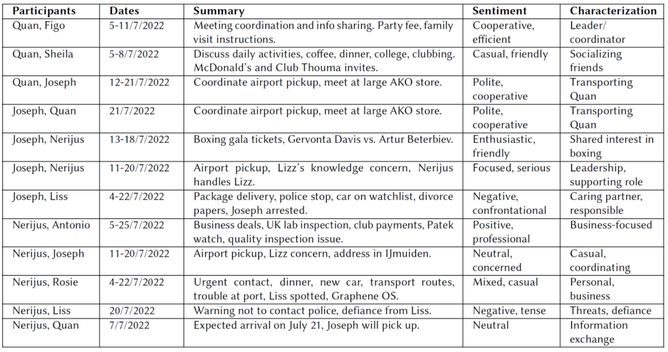
Summary 2: summarize content
Prompt ChatGPT with:
Combined summaries preceded by:
Here is a document containing multiple conversations.
Create a LaTeX table showing participants, dates, summary in max 15 words, sentiment in max 5 words and characterization in max 5 words.

Slide 47
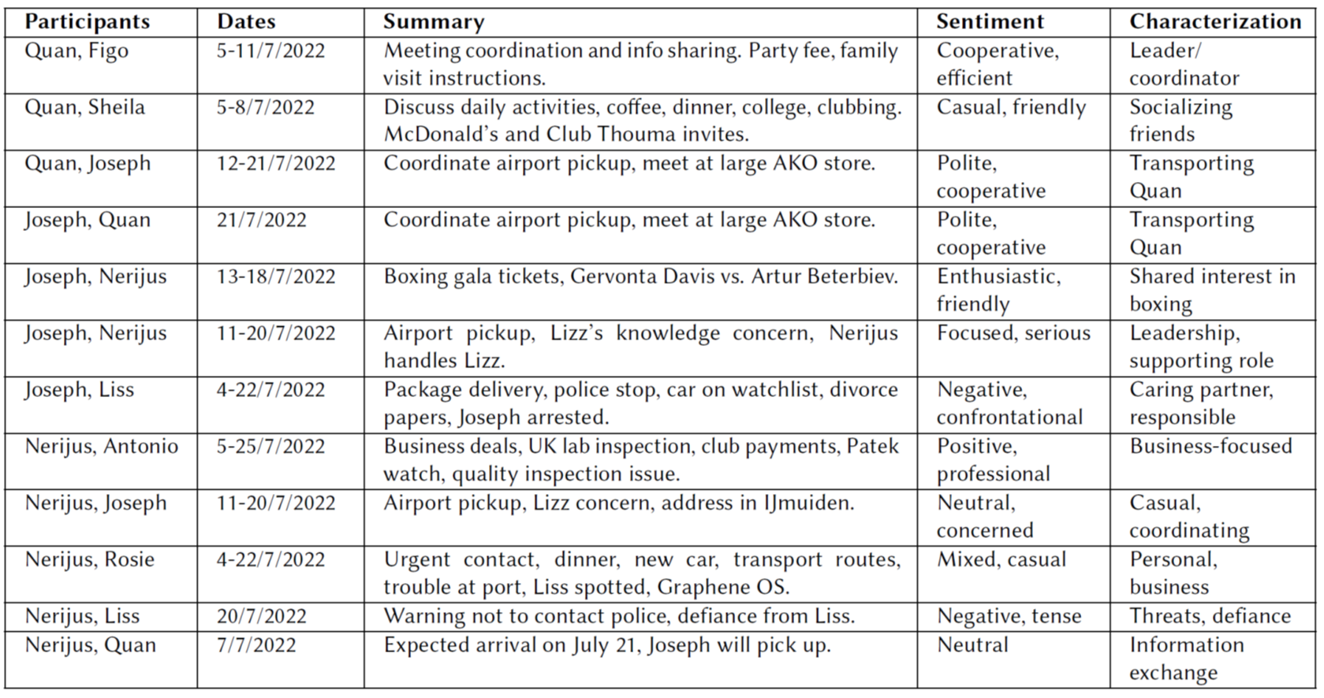

Summary 2: summarize content
Prompt ChatGPT with:
Combined summaries preced by:
Here is a document containing multiple conversations. Create a Latex table showing participants, dates, summary in max 15 words, sentiment in max 5 words and characterization in max 5 words..

Slide 48
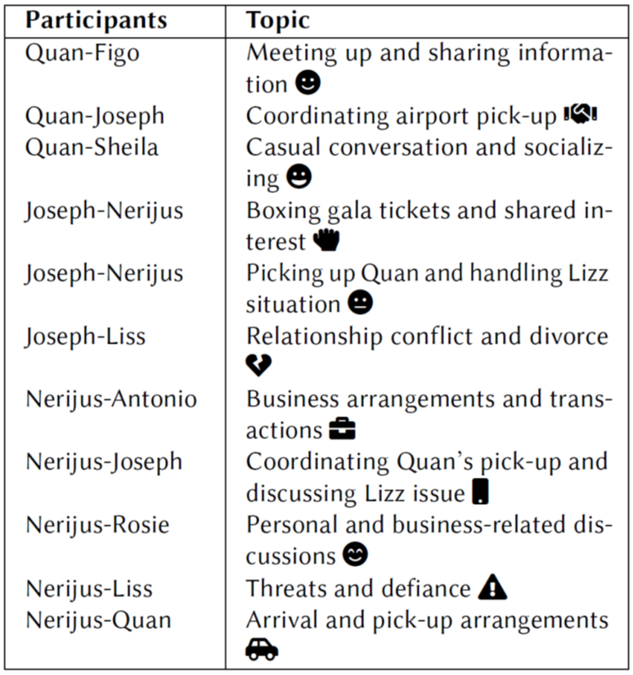
Summary 3: connections and sentiment
Prompt ChatGPT with:
Combined summaries preceded by:
Here is a document containing multiple conversations.
List all names as nodes. List conversations as connections between nodes. Label connections with the topic of the conversation including an emoticon to reflect the sentiment of conversation. Avoid duplicate topics...

Slide 49
Summary 4: visualize
Prompt ChatGPT with:
Output from summary 3 plus list of persons preceded by:
Format the following information using TikZ in a LaTeX figure. Use the fontawesome5 package for the emoticons.
Use the connection text as labels that run along the edges. Use fixed size small circles with gray color and black contour to depict the nodes. Can you define a separate style for the edges and reference this in the draw sections. Use a smaller font for the edge labels. Arrange the nodes so that edges are not crossing.

Slide 50
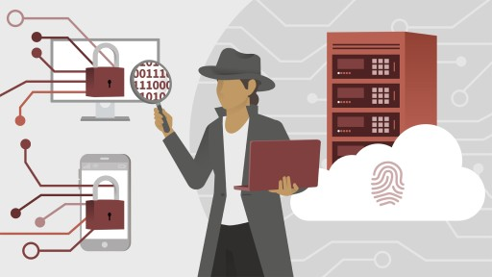
Analyse search results
Can ChatGPT assist with analyzing different types of digital traces?
Browser history
Chat messages
Geo locations

Slide 51
Step 1: Analyse browser history
Prompt ChatGPT:
act as a sleuth
Quan is one of the suspects in this case
analyse browser history url’s
containing the word ’search’
found on the phone from Quan
HQL: type:browserHistory type:search
We only show the first 3 browser history in total there are 50 unique url’s in total.
You are SleuthGPT. You are a detective that is investigating a case. Quan and Joseph were arrested on July 24, 2022 because they were carrying a large sum of cash money. Quan's Motorolo phone and Josephs iPhone 6s were seized as well as the MacBook from Joseph. These devices have been loaded in Hansken and digital traces have been extracted. Here is the browserhistory from Quan's phone. Can you summarize his internet activity including dates and try to understand his motive and possible activities related to money he was carrying with Joseph? "browserHistory.pageTitle","browserHistory.accessedOn","browserHistory.application","browserHistory.visitCount","browserHistoryLog.application","total duplicates","url.host“ "whatsapp group gambling - Google Zoeken","2022-07-04T13:29:18.598Z","Google Chrome",4,"",1,www.google.com "google - Google Zoeken","2022-07-04T13:29:14.057Z","Google Chrome",3,"",1,www.google.com "whatsapp group fitness - Google Zoeken","2022-07-04T13:29:10.843Z","Google Chrome",3,"",1,"www.google.nl"

Slide 52

Step 1: Analyse browser history (answer)
ChatGPT “understands” the dates in the input
ChatGPT automatically groups searches per date
ChatGPT tries to infer how these searches may be related to the large sum of cash he was carrying.
Based on Quan's browser history, here's a summary of his internet activity: 1. On July 4, 2022, Quan searched for "WhatsApp group gambling " and "WhatsApp group fitness.“ 2. On July 5, 2022, he searched for "uu.nl blackboard," "risks drug smuggling," "sentence checker," and "drug trafficking punishment UK.“ 3. On July 9, 2022, Quan looked up information about Class B drugs, London City Airport, flights from Amsterdam to London, and Saowapa, a restaurant in Utrecht. He also searched for “ friends finder Utrecht," "computing science uu," and "gambling addiction.“ 4. On July 20, 2022, he searched for "transpoft for London.“ Based on this information, it seems that Quan might be involved in gambling activities, as he searched for a gambling WhatsApp group and information about gambling addiction. He also showed interest in drug smuggling and trafficking, possibly researching the risks and potential punishments involved. Quan's searches about London City Airport, flights from Amsterdam to London, and London's transportation system indicate that he could have been planning a trip to London, which may be related to the large sum of cash he was carrying with Joseph when they were arrested.

Slide 53
Step 2: Analyse chat messages
Prompt ChatGPT:
provide chat messages extracted from Quan’s phone
ask for a connection between chats and browser history
Here is a summary of chats that we found on Quan's phone. Does this give you a better idea of what Quan has been doing. Do you see a connection between the chats and the browser history both in topic as well as date times? Conversation 1 between Quan (owner) and Figo (31644891202@s.whatsapp.net): 5-7-2022 12:08:53 - 31644891202@s.whatsapp.net: Hi Quan, do you want to meet again or do you have enough information? 5-7-2022 12:09:22 - owner: i know enough! 5-7-2022 12:09:31 - 31644891202@s.whatsapp.net: Excellent
...

Slide 54
Step 2: Analyse chat messages (answer)
ChatGPT relates chat messages to the topics and dates of Quan’s browser history and
ChatGPT notes that Quans’ searches on July 6th occurred after his conversation with Figo on July 5th.
Based on the chats found on Quan's phone, it appears that Quan may have been involved in some potentially illegal activities. The conversations with Figo (31644891202@s.whatsapp.net)mention buying a suitcase for a transfer, paying cash to leave no traceable receipt, and sending photos of drugs and a lab via Snapchat. These activities could be related to the browser history, particularly the searches on transferring money and drug production. The conversations with Sheila (+31685197340) and Joseph (31647730075@s.whatsapp.net) seem to be more casual and focused on social activities, such as going to McDonald's, visiting a club, and meeting family members in Germany. However, the conversation with Joseph does mention Quan's flight details and airport meet-ups, which could be relevant to the investigation. The connection between the chats and the browser history is not only in the topics discussed but also in the dates. The conversation with Figo about the suitcase and drugs takes place on 5-7-2022, while the browser history shows searches related to transferring money and drug production on 6-7-2022. This suggests that Quan may have been researching these topics after discussing them with Figo.

Slide 55
Step 3: Analyse geolocations
Prompt ChatGPT:
provide GPS location traces HQL: gps.latlong:*
ask to summarize
ask to interpret the geo-locations
ask for a relation to chats and browser history
We found the following gps locations on Quan's phone. Can you give a summary of the locations and dates Quan has been assuming that he took the pictures. Can you interpret the geolocation and give a name instead? Is there any relation to activities mentioned in the browser history and chats that you found earlier? "name","gps.createdOn","gps.latlong","gps.misc","gpsLog.application","gps.application“ "IMG_20220715_072808635_HDR.jpg","2022-07-15T07:28:09.274Z","+52.30876+004.76278","","","“ "IMG_20220715_072847128_HDR.jpg","2022-07-15T07:28:47.824Z","+52.30864+004.76151","","",""

Slide 56
Step 3: Analyse geolocations (answer)
ChatGPT “understands” that .jpg refers to images, but
hallucinates (!) when translating GPS locations to places
ChatGPT remembers that Joseph and Quan talked about meeting at the airport and
suggests this could be Schiphol because pictures have been taken in Amstelveen which is close to Schiphol.
ChatGPT states that this connection is speculative and does require further investigation
Based on the GPS coordinates found in the images, here is a summary of the locations and dates Quan has been: 1. 2022-07-15: Two locations close to each other in Amsterdam, Netherlands, near the intersection of Parnassusweg and Strawinskylaan. IMG_20220715_072808635_HDR.jpg: 52.30876, 4.76278,IMG_20220715_072847128_HDR.jpg: 52.30864, 4.76151 2. 2022-07-21: Two locations in Amsterdam, Netherlands, near the intersection of Parnassusweg and Gustav Mahlerlaan. IMG_20220721_094819167_HDR.jpg: 52.30436, 4.75076 IMG_20220721_092831675.jpg: 52.30995, 4.76099 3. 2022-07-09: One location in Amstelveen, Netherlands, near the intersection of Keizer Karelweg and Graaf Aelbrechtlaan. IMG_20220709_132100583_HDR.jpg: 52.25898, 4.5536, IMG_20220709_132021308_HDR.jpg: 52.25897, 4.55371, IMG_20220709_132050518_HDR.jpg: 52.25898, 4.55369, IMG_20220709_132058716_HDR.jpg: 52.25898, 4.55369 These locations do not show a direct connection to the browser history and chats, but they provide a general idea of Quan's movements during that time period. The images were taken in Amsterdam and Amstelveen, which are in the Netherlands. The chat with Sheila (+31685197340) on 7-7-2022 mentioned going to Club Thouma, which could be located in or around Amsterdam. The conversation with Joseph (31647730075@s.whatsapp.net) on 21-7-2022 mentioned meeting at the airport, which could be Amsterdam Airport Schiphol (also in the Netherlands). However, these connections are speculative and would require further investigation to confirm.

Slide 57
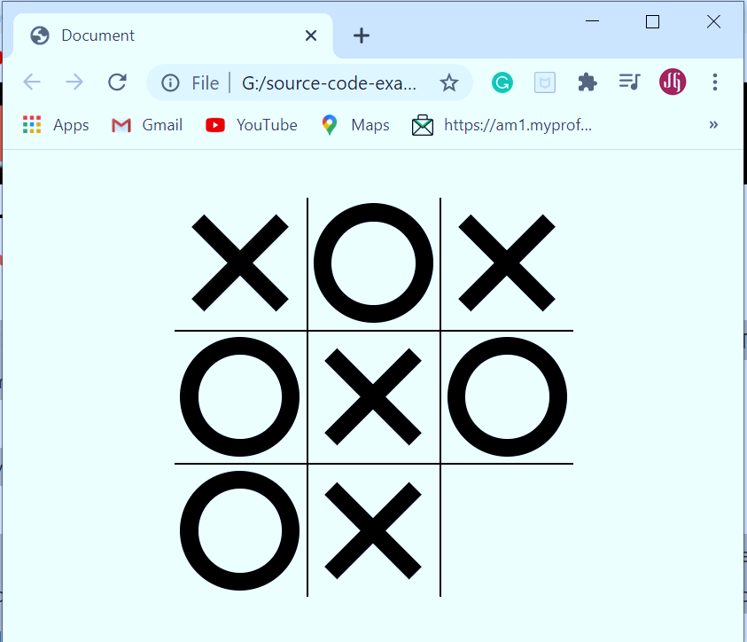
Reverse engineering experiment
Tic-Tac-Toe program:
script.js
index.html
style.css
Two-step obfuscation script.js:
Manually rename function and variable names to function1, function2, variable1, variable2 etc.
Then use machine obfuscation https://obfuscator.io/
Prompt ChatGPT with the following tasks:
What does the following javascript code do?
Can you convert this to javscript?
Fix the code so that it works index.html, style.css
Add comments and use meaningful names
https://www.sourcecodeexamples.net/2020/09/javascript-tic-tac-toe-game.html

Slide 58
Step 1: Reverse engineering
Prompt: Do you understand what the following code is doing?
const _0x41d3b8=_0x416e;(function(_0x4e7330,_0x1b8a19){const _0x5acae3=_0x416e,_0x437bef=_0x4e7330();while(!![]){try{const _0x45db50=parseInt(_0x5acae3(0x179))/0x1*(-parseInt(_0x5acae3(0x187))/0x2)+-parseInt(_0x5acae3(0x189))/0x3+parseInt(_0x5acae3(0x17f))/0x4+-parseInt(_0x5acae3(0x17a))/0x5*(parseInt(_0x5acae3(0x16e))/0x6)+-parseInt(_0x5acae3(0x16c))/0x7+-parseInt(_0x5acae3(0x17b))/0x8*(parseInt(_0x5acae3(0x186))/0x9)+-parseInt(_0x5acae3(0x175))/0xa*(-parseInt(_0x5acae3(0x16d))/0xb);if(_0x45db50===_0x1b8a19)break;else _0x437bef['push'](_0x437bef['shift']());}catch(_0x40f2bc){_0x437bef['push'](_0x437bef['shift']());}}}(_0x4952,0xa16c7));const var1=_0x41d3b8(0x188),var2='string7',var3=[[0x0,0x1,0x2],[0x3,0x4,0x5],[0x6,0x7,0x8],[0x0,0x3,0x6],[0x1,0x4,0x7],[0x2,0x5,0x8],[0x0,0x4,0x8],[0x2,0x4,0x6]],var4=document[_0x41d3b8(0x18b)](_0x41d3b8(0x176)),var5=document[_0x41d3b8(0x178)](_0x41d3b8(0x180)),var6=document[_0x41d3b8(0x178)](_0x41d3b8(0x185)),var8=document[_0x41d3b8(0x178)](_0x41d3b8(0x177)),var7=document['querySelector'](_0x41d3b8(0x17d));let var10;function1(),var8['addEventListener'](_0x41d3b8(0x18d),function1);function function1(){const _0x34964a=_0x41d3b8;var10=![],var4[_0x34964a(0x181)](_0x58299f=>{const _0x51788e=_0x34964a;_0x58299f[_0x51788e(0x18a)]['remove'](var1),_0x58299f[_0x51788e(0x18a)][_0x51788e(0x17e)](var2),_0x58299f[_0x51788e(0x18c)](_0x51788e(0x18d),function2),_0x58299f[_0x51788e(0x173)]('click',function2,{'once':!![]});}),function7(),var6[_0x34964a(0x18a)][_0x34964a(0x17e)]('show');}function _0x416e(_0x43032e,_0x2940a0){const _0x4952d0=_0x4952();return _0x416e=function(_0x416ed3,_0xacd218){_0x416ed3=_0x416ed3-0x16b;let _0x1f0cc4=_0x4952d0[_0x416ed3];return _0x1f0cc4;},_0x416e(_0x43032e,_0x2940a0);}function function2(_0x46ad05){const _0x402517=_0x41d3b8,_0x3bc8c4=_0x46ad05[_0x402517(0x171)],_0x5dd1cd=var10?var2:var1;function5(_0x3bc8c4,_0x5dd1cd);if(function8(_0x5dd1cd))function3(![]);else function4()?function3(!![]):(function6(),function7());}function function3(_0x483c2c){const _0x311b64=_0x41d3b8;_0x483c2c?var7[_0x311b64(0x183)]=_0x311b64(0x170):var7['innerText']=(var10?_0x311b64(0x170):_0x311b64(0x16f))+_0x311b64(0x172),var6[_0x311b64(0x18a)][_0x311b64(0x184)](_0x311b64(0x17c));}function function4(){return[...var4]['every'](_0x3fdd07=>{const _0x1b7f5c=_0x416e;return _0x3fdd07[_0x1b7f5c(0x18a)][_0x1b7f5c(0x182)](var1)||_0x3fdd07[_0x1b7f5c(0x18a)][_0x1b7f5c(0x182)](var2);});}function function5(_0xb6006a,_0x28844d){const _0x1fa33f=_0x41d3b8;_0xb6006a[_0x1fa33f(0x18a)]['add'](_0x28844d);}function function6(){var10=!var10;}function function7(){const _0x11683a=_0x41d3b8;var5['classList']['remove'](var1),var5[_0x11683a(0x18a)][_0x11683a(0x17e)](var2),var10?var5[_0x11683a(0x18a)]['add'](var2):var5[_0x11683a(0x18a)]['add'](var1);}function function8(_0x1f2fba){const _0x22be20=_0x41d3b8;return var3[_0x22be20(0x174)](_0x30ecc7=>{const _0x400e64=_0x22be20;return _0x30ecc7[_0x400e64(0x16b)](_0x22bb0e=>{const _0x3c228e=_0x400e64;return var4[_0x22bb0e][_0x3c228e(0x18a)][_0x3c228e(0x182)](_0x1f2fba);});});}function _0x4952(){const _0x3bdb6b=['36hGVUzQ','string9','string8','target','\x20string10','addEventListener','some','170ZgWRRv','[string5]','string2','getElementById','1EMvWni','1041685wWIgyL','3400fxOIHu','string11','[string1]','remove','3439900SfBhBb','string4','forEach','contains','innerText','add','string3','207mUWVli','1270406aWRMoi','string6','105501bLWJBU','classList','querySelectorAll','removeEventListener','click','every','7050386XxqjOf','1772023wRUhSn'];_0x4952=function(){return _0x3bdb6b;};return _0x4952();}

Slide 59
Step 1: Reverse engineering (answer)
ChatGPT recognizes that the code is javascript code implementing Tic-Tac-Toe
It explains what the code does in 4 steps and concludes with noting that the code is not easy to read.
This code is a minified and obfuscated version of JavaScript code, which makes it difficult to understand. However, I can provide a high-level explanation of its functionality. The script appears to be implementing a simple Tic Tac Toe game, with two players taking turns to make their moves. The game board is a 3x3 grid, and the goal is to get three in a row, either horizontally, vertically, or diagonally. Here’s a brief overview of the code: 1. The code starts by defining some variables and functions, which are obfuscated using hexadecimal values and string manipulation. 2. It then sets up the game board by selecting the necessary HTML elements, such as the grid cells and status messages. 3. The game logic is implemented through several functions, which handle actions like updating the grid, checking for a win, or a draw, and switching between players. 4. Event listeners are added to the grid cells, so the game responds to user clicks. Please note that the code is not easy to read, and it would be much better to write this in a more human-readable format for easier understanding and maintenance.

Slide 60
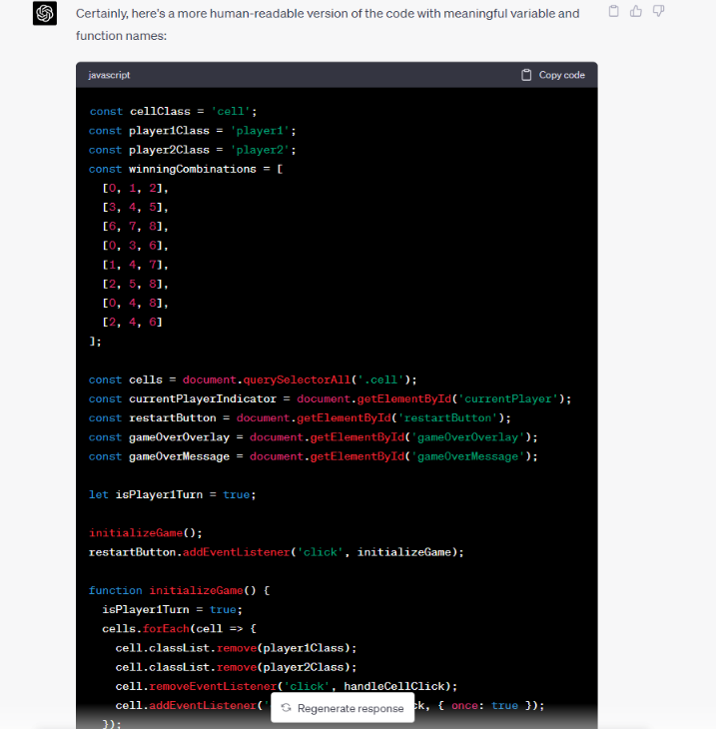
Step 2: Conversion to javascript
Prompt: Can you rewrite this as javascript with meaningful names?
Answer: Certainly, here's a more human-readable version of the code with meaningful variable and function names:

Slide 61
Step 3&4: Fix index and style, add comments
Problem with the index.html and style.css file
Prompts:
Can you make this script work with the following html and css page
Include comments with the code and winning board positions
This updated script should work seamlessly with the provided HTML and CSS files. Make sure to save the JavaScript code as "scriptc.js" (as mentioned in the HTML file) and ensure that all files (HTML, CSS, and JavaScript) are in the same directory. The provided JavaScript code works as follows: 1. Define constants for class names and winning combinations. 2. Select DOM elements for the board, cells, winning message, winning message text, and restart button. 3. Define a variable isPlayer1Turn to track the current player’s turn. 4. Initialize the game by setting up the initial state and adding a click listener to the restart button. 5. Define initializeGame function to reset the game state and set up click listeners on cells. 6. Define handleCellClick function to handle the game logic on cell click, such as marking the cell, checking for win or draw, and switching players. 7. Define gameOver function to display the winning message based on the result (win or draw). 8. Define checkDraw function to check if all cells are marked,indicating a draw. 9. Define markCell function to mark the cell with the current player’s class. 10. Define switchPlayer function to switch the player and update the board’s class accordingly. 11. Define checkWin function to check if the current player’s marked cells match any of the winning combinations. With this implementation, you should have a fully functional Tic Tac Toe game with the provided HTML and CSS files.

Slide 62
Step 3&4: Fix index and style, add comments
I've updated the JavaScript code to work with the provided HTML and CSS files. I've also added comments to explain the code and the winningCombinations array. Here's the updated JavaScript code:
// Define constants for classes and winning combinations
const cellClass = 'cell';
const player1Class = 'x';
const player2Class = 'circle';
// Winning combinations are arrays of cell indices that form a win
// Horizontals: [0, 1, 2], [3, 4, 5], [6, 7, 8]
// Verticals: [0, 3, 6], [1, 4, 7], [2, 5, 8]
// Diagonals: [0, 4, 8], [2, 4, 6]
const winningCombinations = [
[0, 1, 2],
[3, 4, 5],
[6, 7, 8],
[0, 3, 6],
[1, 4, 7],
[2, 5, 8],
[0, 4, 8],
[2, 4, 6]
];
// Select DOM elements
const board = document.getElementById('board');
const cells = document.querySelectorAll('[data-cell]');
const winningMessageElement = document.getElementById('winningMessage');
const winningMessageTextElement = document.querySelector('[data-winning-message-text]');
const restartButton = document.getElementById('restartButton');
// Define a variable to track the current player's turn
let isPlayer1Turn = true;
// Initialize the game and add a click listener to the restart button
initializeGame();
restartButton.addEventListener('click', initializeGame);
function initializeGame() {
isPlayer1Turn = true;
cells.forEach(cell => {
cell.classList.remove(player1Class);
cell.classList.remove(player2Class);
cell.removeEventListener('click', handleCellClick);
cell.addEventListener('click', handleCellClick, { once: true });
});
board.classList.remove(player1Class, player2Class);
board.classList.add(isPlayer1Turn ? player1Class : player2Class);
winningMessageElement.classList.remove('show');
}
function handleCellClick(event) {
const clickedCell = event.target;
const currentPlayerClass = isPlayer1Turn ? player1Class : player2Class;
markCell(clickedCell, currentPlayerClass);
if (checkWin(currentPlayerClass)) {
gameOver(false);
} else if (checkDraw()) {
gameOver(true);
} else {
switchPlayer();
}
}
function gameOver(isDraw) {
winningMessageTextElement.innerText = isDraw
? 'It\'s a draw!'
: `${isPlayer1Turn ? 'Player 1' : 'Player 2'} wins!`;
winningMessageElement.classList.add('show');
}
function checkDraw() {
return Array.from(cells).every(cell => {
return cell.classList.contains(player1Class) || cell.classList.contains(player2Class);
});
}
function markCell(cell, playerClass) {
cell.classList.add(playerClass);
}
function switchPlayer() {
isPlayer1Turn = !isPlayer1Turn;
board.classList.remove(player1Class, player2Class);
board.classList.add(isPlayer1Turn ? player1Class : player2Class);
}
function checkWin(playerClass) {
return winningCombinations.some(combination => {
return combination.every(index => {
return cells[index].classList.contains(playerClass);
});
});
}
Problem with the index.html and style.css file
Prompts:
Can you make this script work with the following html and css page
Include comments with the code and winning board positions
This updated script should work seamlessly with the provided HTML and CSS files. Make sure to save the JavaScript code as "scriptc.js" (as mentioned in the HTML file) and ensure that all files (HTML, CSS, and JavaScript) are in the same directory. The provided JavaScript code works as follows: 1. Define constants for class names and winning combinations. 2. Select DOM elements for the board, cells, winning message, winning message text, and restart button. 3. Define a variable isPlayer1Turn to track the current player’s turn. 4. Initialize the game by setting up the initial state and adding a click listener to the restart button. 5. Define initializeGame function to reset the game state and set up click listeners on cells. 6. Define handleCellClick function to handle the game logic on cell click, such as marking the cell, checking for win or draw, and switching players. 7. Define gameOver function to display the winning message based on the result (win or draw). 8. Define checkDraw function to check if all cells are marked,indicating a draw. 9. Define markCell function to mark the cell with the current player’s class. 10. Define switchPlayer function to switch the player and update the board’s class accordingly. 11. Define checkWin function to check if the current player’s marked cells match any of the winning combinations. With this implementation, you should have a fully functional Tic Tac Toe game with the provided HTML and CSS files.

Slide 63
Exercise Example 6: Jupyter notebook illustrating how ChatGPT can be your copilot in data analytics and visualisation

Slide 64
14:15-14:30

Slide 65
Student project part 1: design a project that you will finish Friday

Slide 66
Student projects
Goal: test your skill in Data Analytics and Visualization for Digital Forensics
How to do this:
Think of a digital forensic use case:
Investigation question
Data sources
Where to get the data?
Perhaps from earlier FS CAS DFCI modules (malware, network forensics)
Or from scenarios at https://digitalcorpora.org/
Or from your own firewall, pc, laptop or phone …
Or use ChatGPT to create a test data set or a program that can create test data …

Slide 67
Student projects schedule: part 1/2
Day 3 14:30-16:00 start of your project
Day 3 16:00-16:30 2 minute pitch of your project idea
Day 4 14:00-16:30 continue working on your project
Day 5 13:00-15:00 9x 10 minute presentations
Day 5 15:00-15:30 break
Day 5 15:30-16:30 grading and evaluation
Grades will be based on 3 elements in the presentation
Reflection of what you have learned this week
Data analytics part (loading, cleaning and transforming data)
Data visualisation part

Slide 70
Contact information
Dr.ir. Hans Henseler
henseler.h@hsleiden.nl

